Slide 1
Using PMI as supervised signal with MOOSE

Slide 2
Target
Planning
Use PMI score calculated from corpus(BNC) as a signal to instruct MOOSE to reproduce and distribute more sensible Trait scores.
Adding PMI score at early stage of BERT training (one of the first 4 layers out of 12 layars for each BERT)

Slide 3
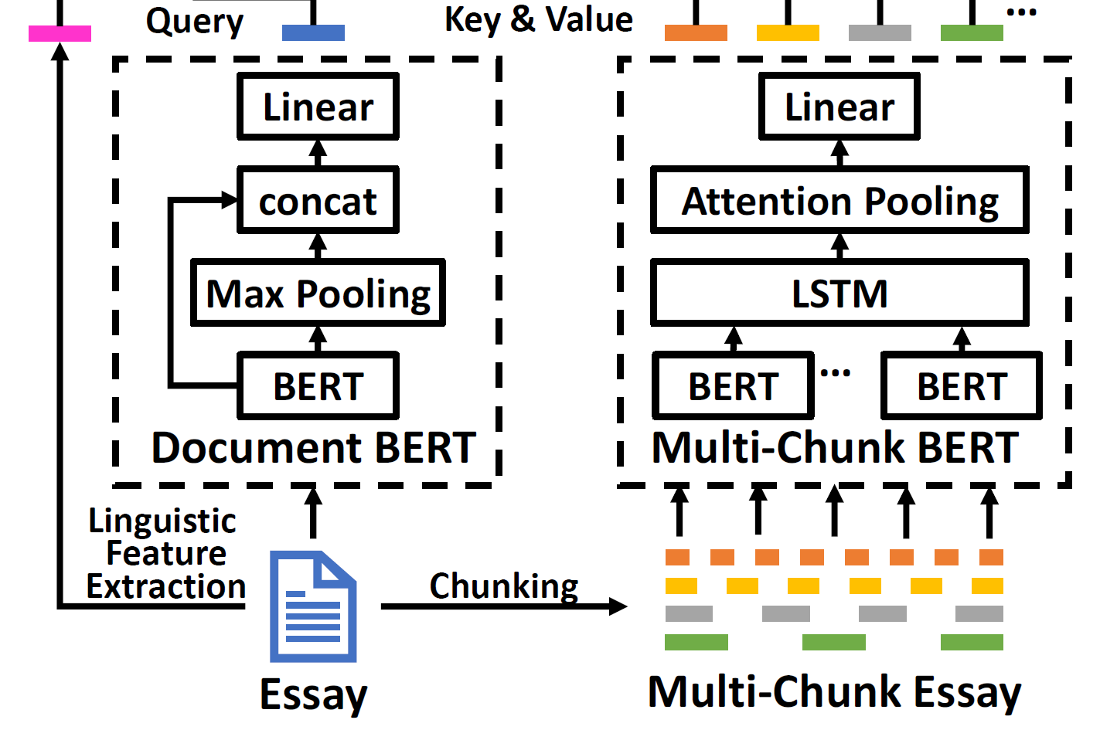
Model structure
Each Bert(base) has 12 layers, we plan to add PMI scores as an instructive value for the first 4 layers.
We first try it on the Document Bert, since it’s input is all document. We can decide how to do with multi-chunk Bert according to the performance for Document Bert.

Slide 4
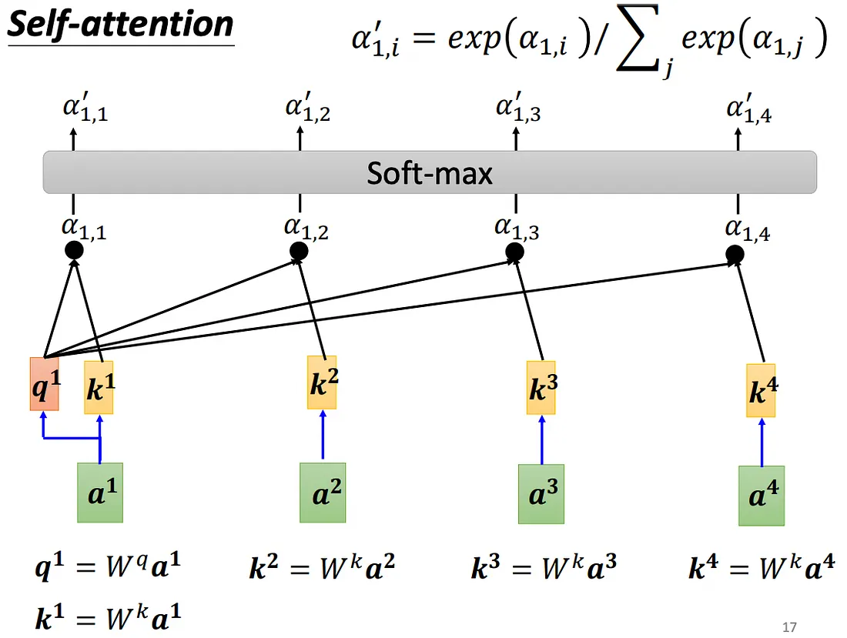
Bert modification
Traits
Moose Structure
We insert PMI value as an instruct signal
other layers (11 layers)
PMI value
Labeled-attention
Layer 1
Layer 1
Notes:
label 的 softmax跟圖的softmax做
mask掉其他只看collocation 拿出self attention的layer做MSE

Slide 5
Label (畫圖)
往後抓五個(斷句) 用pmi值 抓pair 其他-inf ###ing問題 把前一個的分數也傳進去例如 playing的分數傳播到play ###ing
說明n*n矩陣

Slide 6
Word Correction using LLM

Slide 7
Word Correction attempts
python plugin (e.g Textblob, Fasttext, symspellpy)
Symspellpy & vennify/t5-base-grammar-correctionT5
Symspellpy & mistralai/Mistral-7B-Instruct-v0.3
Symspellpy & google/gemma-2-2b-it
A A A AB(C)
I define the level of mispelled words
A : simple mispelled (e.g forbidde, troble)
B : plural mispelled (e.g countrys, ourselfs)
C : space replacement and abbreviation (e.g “now adays” , “ect”)

Slide 8
Word correction framework
We use Symspellpy to separate the mispelled sentences from documents.
Use those mispelled sentences as input of Language Model
Inspecting the output to decide whether change Language Model or not
document
Symspellpy
mispelled sentences
Language Model
Corrected Words
(Prompt Engineering)

Slide 9
Word correction framework
Since the collocation has been captured using the mispelled documents, even though we fixed the mispelled problem, we still need to update the collocation database to apply the corrected collocation.

